Slide 1



Jordan’s Principle
Program
Regional Psychology Group
October 11, 2024

Slide 2
Southern Chiefs’ Organization
The Southern Chiefs’ Organization represents 33 Anishinaabe and Dakota Nations and more than 87,000 citizens in what is now called southern Manitoba.
SCO is an independent political organization that protects, preserves, promotes, and enhances First Nations peoples’ inherent rights, languages, customs, and traditions through the application and implementation of the spirit and intent of the Treaty-making process.

Slide 3
Honouring Jordan River Anderson
Jordan’s Principle is named in memory of Jordan River Anderson, a young boy from Norway House Cree Nation in Manitoba. Jordan was born in 1999 with complex medical needs and stayed in the hospital from birth.
When Jordan was two years old, doctors said he could move to a special home for his medical needs. However, the federal and provincial governments could not agree on who should pay for his home-based care. As a result, Jordan never got to spend even one night at home, and he passed away at the age of five in the hospital.
In 2007, the House of Commons passed “Jordan’s Principle”, a commitment to ensure First Nation children would get the products, services and supports they need, when they need them. It covers a wide range of health, social and educational needs.

Slide 4
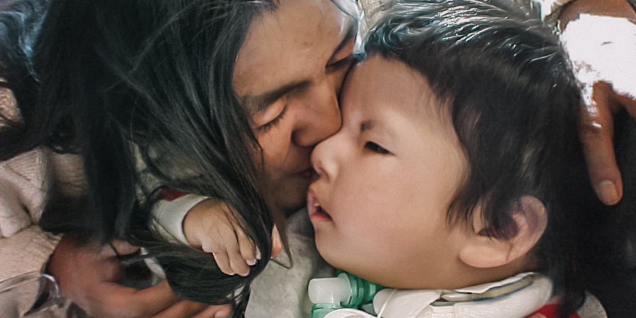
Jordan’s Principle is a legal requirement resulting from Canadian Human Rights Tribunal rulings that aims to eliminate service inequities and delays for First Nation children. Jordan’s Principle states that any public service ordinarily available to all other children must be made available to First Nation children without delay or denial.

Slide 5
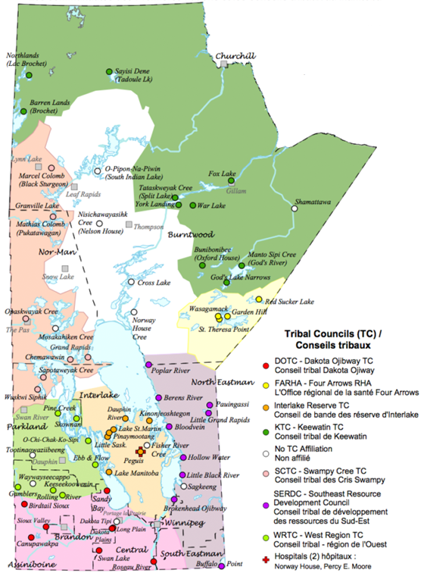
Jordan’s Principle Providers
As a unique model from other regions across the country, Indigenous Services Canada provides funding to First Nation communities and organizations in Manitoba to adjudicate and provide Jordan’s Principle services and supports. This is delivered through:
63 First Nations
7 Tribal Councils
3 PTOs
2 Out-of-Province Organizations

Slide 6
Jordan’s Principle Coordinators
In 2019, the Southern Chiefs’ Organization developed a partnership with the Specialized Services for Children and Youth (SSCY) Centre and the Winnipeg Children’s Hospital to improve health outcomes for First Nation children.
Jordan’s Principle services are available to families accessing health care at these facilities, as well as the pediatric area of CancerCare Manitoba and the Woman’s Hospital.
These supports are open to all eligible First Nation children regardless of residency.

Slide 7
Jordan’s Principle Coordinators
In early 2022, the Southern Chiefs’ Organization and the Winnipeg School Division came together to improve outcomes for First Nation students by co-creating a Jordan’s Principle Coordinator position based within the division.
This concept expanded and through additional partnerships, a Jordan’s Principle Coordinator role began in the following metro and southern school divisions:
Brandon
Hanover
Lord Selkirk
Louis Riel
Pembina Trails
Portage la Prairie
River East Transcona
Seven Oaks
St. James-Assiniboia
Sunrise

Slide 8
Jordan’s Principle Coordinators
This past fall, we worked with Indigenous Services Canada to devolve oversight and administration of Tutoring Services from the regional office to the SCO Jordan’s Principle program.
Our two Tutoring Services Coordinators work with families, tutoring vendors and stakeholders to ensure children from across Manitoba receive quality and safe access to the additional education supports that they require.

Slide 9
How do we help?
Our Jordan’s Principle Coordinators can assist families and facility staff in accessing programs, services and supports to help improve health, education and social outcomes for First Nation children by:
assisting caregivers and service providers with Jordan’s Principle applications and/or appeals
processing applications in-house to prevent delays and/or providing timely referrals to appropriate agencies if required
providing navigation to existing programs, services and agencies
offering education and information on types of supports and services Jordan’s Principle can provide to eligible First Nation and Inuit children
collaborating with service providers and stakeholders to provide wrap-around services for children and families in need

Slide 10
Types of Support
School supplies and fees
Learning devices and sensory tools
Educational assistants
Transportation
In-school extracurricular
Specialized medical supplies and equipment
Prescriptions
In-hospital newborn supports
Palliative care supports
Financial coverage of supports and services offered through Jordan's Principle are unique to each child's needs and may include (but not limited to)…

Slide 11
Jordan’s Principle Eligibility & How to Apply
Eligibility:
Must be a First Nation or Inuit child who:
  has a First Nation Status or Inuit number, or
  is eligible for Status via a parent with a Status or Inuit number
Up to 18 years of age
Completes a Jordan’s Principle application and is not receiving the same service/support from another source
How to Apply:
Self-referral
  Families/caregivers can contact the Jordan’s Principle Coordinator directly
Through SCO partner sites
  Health and education staff can make a referral to their designated Jordan’s Principle Coordinator
Referrals from third parties
  Applications may be directed to SCO by outside agencies

Slide 12
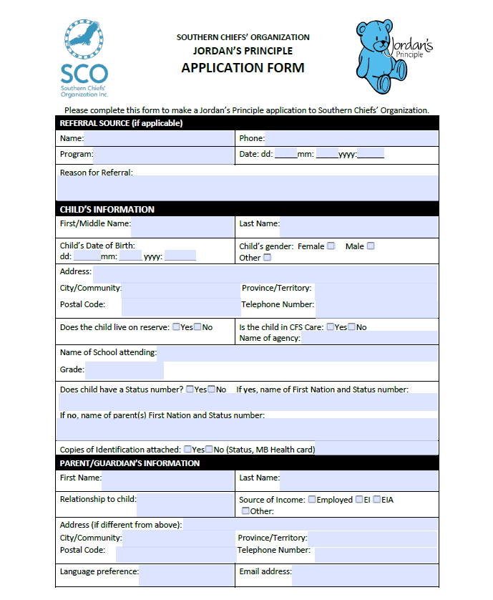
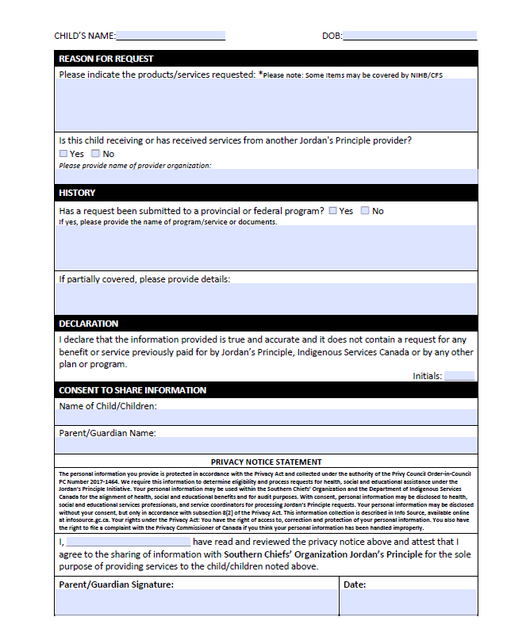

Slide 13
** SNAPSHOT **
2023-2024
SCO’s Jordan’s Principle supported
6,000+
Children and Youth
25,000+
Jordan’s Principle requests

Slide 14
CONTACT US TODAY!
JORDAN’S PRINCIPLE PROGRAM
Southern Chiefs’ Organization
T: 204.946.1869 ext. 205
TF: 1.866.876.9701
Hours: Monday – Friday, 8:30 am – 4:30 pm
E: jpadmin@scoinc.mb.ca
W: www.scoinc.mb.ca/jp-program/

