Slide 1

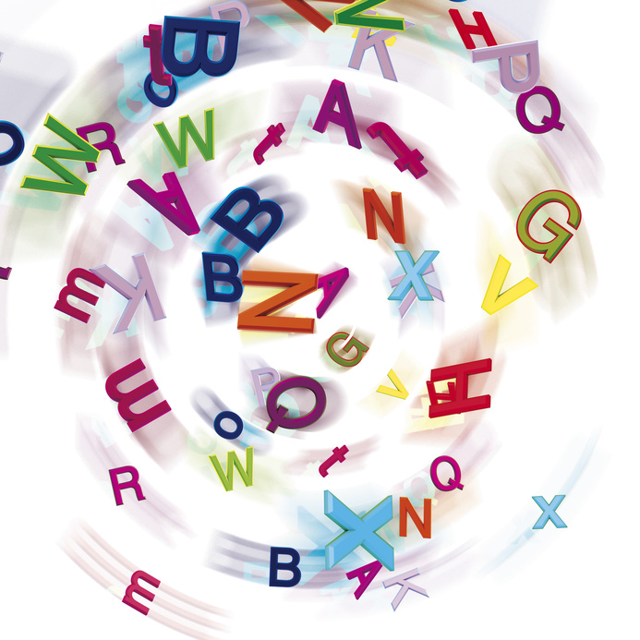

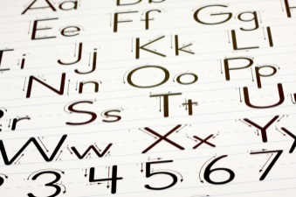

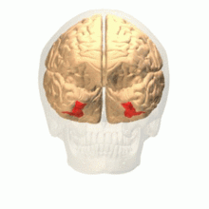



Orthographic Processing:
Welcome to the next era of literacy instruction
Visualizing Written Language
Let’s attain a new orthographic awareness.

Slide 2

The evolution of reading instruction…
Notes:
In this presentation, I’m going to take you back in time to about the year 1900 and trace the evolution of reading instruction up to the present, highlighting significant advances along the way, before proposing what I believe is the next stage of reading instruction evolution: orthographic awareness.

Slide 3
Two Branches of Reading Evolution
Regular Education
Special Education
Reading methods developed in universities and schools primarily by teachers for all students
Reading methods developed
in universities, hospitals, and
private clinics by doctors,
psychologists, & teachers for
disabled readers
Development guided more by trial & error, anecdote, and philosophy
Development guided more by theories of brain function & scientific method
More recently
Merging
Notes:
There has been two main branches in the evolution of reading instruction. The developmental route of regular education for most students, and the special education route for students with reading disabilities. More recently, the science guiding the special education route has been influencing the instructional practices in regular education. For example, Dr. David Sousa’s 2014 book entitled, “How the Brain Learns to Read” covers the latest brain science and its application to reading instruction for teachers of all students.

Slide 4
Evolution of Reading Instruction
1900-1930: Sentence recitation method, then sound-symbol
1930-1960: “Dick & Jane” – whole word & controlled vocab.
  1948 - William S. Gray argued in his book “On Their Own Reading” for the “Look-Say” method.
  1955 - Rudolf Flesch argued in his book “Why Johnny Can’t Read” for “Phonics.”
1960-1970: Mix of Phonics, Basal Readers, Initial Teaching Alphabet, Whole Word, & Language Experience approaches.
  In 1967, Dr. Jeanne Chall’s book “Learning to Read: The Great Debate” reviewed 30 studies: 18 supported Phonics, whereas only 3 supported Look-Say.
1970 to the mid-1980s:
  Phonics instruction used, with basal readers, word families, & workbooks.
Notes:
Since 1900, teachers in regular education started out teaching children to read using the sentence recitation method, and then moved into aspects of sound-symbol relationships, although there was no consensus for which method was best. During the 20th century, there was an ongoing disagreement among educators about whether holistic or analytic methods were the best form of instruction to teach reading. In the 30s and up until the mid 60s, the Dick & Jane basal readers with their whole-word method were quite prominent. The idea for Dick & Jane was conceived by a teacher named Zerna Sharp, and promoted by Dr. William S. Gray from the University of Chicago, who along with several others, was one of the main authors of the series. In 1948, he argues for the Look-Say (whole-word) method to teaching reading using his basal series. Yet, there were many children who had difficulty learning to read using this method. In 1955, Rudolf Flesch argued for the use of phonics to teach children to read in his book “Why Johnny Can’t read.” This was a popular book widely read by the general public who put pressure on the government to have schools adopt phonics instruction. During the 1960s, a time of great social and cultural change, there were several reading methods (e.g., initial teaching alphabet – which didn’t work, basal readers, whole word, language experience, etc.) experimented with. During this time, educators argued about which method was best: whole word or phonics. In 1967, Dr. Jeanne Chall from Harvard argued in her book “Learning to read: The Great Debate” that phonics was superior to the whole word method. In the 1970s to the mid 1980s, phonics was used primarily in schools, along with basal readers, word families, and phonics workbooks. But some teachers thought that phonics instruction was boring and looked for something else.

Slide 5
Development of Remedial
Methods for Dyslexia
1920s – Dr. Grace Fernald developed a multisensory (VAKT) method at UCLA that involved tracing whole words.
1925 – Dr. Samuel T. Orton developed a causal theory for strephosymbolia (twisted symbols: reversals & transpositions), later termed “dyslexia.”
1932 – Marion Munroe developed an expectancy formula to diagnose reading disabilities, & recommended synthetic phonics during individualized remedial reading.
1935 – Anna Gillingham published the “Orton-Gillingham Method” to teach systematic multisensory phonics to dyslexic individuals.
1960s – Beth Slingerland applied the Orton-Gillingham Method to groups of children.
1970s – Pat Lindamood developed the Auditory Discrimination In-Depth Program in California.
Modern Derivatives: Barton, Wilson, Spalding, SPIRE, Language! etc.
Notes:
Dr. Grace Fernald was an educational psychologist who worked with poor readers at UCLA in the 1920s. Based on the “hands-on” ideas of Maria Montessori (an Italian physician who later became an educator of individuals with intellectual disabilities) and Helen Keller (a blind & deaf educator who learned to read using braille), Grace Fernald developed a method of reading instruction for students with reading disabilities that relied on tracing each letter of whole words. Although the method was slow and laborious, teaching several words at a time, many disabled readers eventually learned how to read.
Dr. Samuel T. Orton was a neurologist who worked with stroke victims who lost the ability to read. He also worked with a group of boys who appeared intelligence, yet did not develop the ability to read. He saw similarities between the boys and the older stroke victims, who had left hemisphere damage. In 1925, he theorized that youth with what he termed “strephosymbolia” (i.e., a reading disability involving letter reversals and transpositions) were suffering from difficulty establishing cerebral dominance in the left hemisphere, the seat of language processing, because of the interference from the right hemisphere. Although Dr. Rudolph Berlin, a German ophthalmologist, had coined the term “dyslexia” in 1887 to refer to bright individuals who never learned to read, the term was not commonly used until later.
In 1932, Dr. Marion Munroe, an educational psychologist from the University of Chicago, developed an expectancy formula to diagnose reading disabilities. She used the Stanford Binet to help establish a reading aptitude. She believed that individualized reading interventions should be based on a thorough assessment of a student’s unique profile of strengths and weaknesses, although she advocated synthetic phonics.
Anna Gillingham was an educational psychologist who together with a teacher named Bessie Stillman created a multisensory phonics method based on Samuel Orton’s theory. There are about 10 methods that are derived from the Orton-Gillingham Method, including the Barton, Wilson, Spalding, Spire, etc.
Beth Slingerland was a teacher on the West coast of the US who had gone to some conferences about the Orton-Gillingham method. She got to know Anna Gillingham and worked with her for a couple of years. Her contribution was to apply the teaching method to whole classrooms of children, instead of working with only individuals as had been the practice beforehand. Dr. Virginia Berninger got the idea of testing orthographic awareness from a subtest on the Slingerland Screening Tests. She later adapted it for the PAL test. Beverly Wolf, who became an expert in the Slingerland method, co-authored an authoritative book with Dr. Virginia Berninger entitled, “Teaching Students with Dyslexia and Dysgraphia: Lessons from teaching and Science.”
Pat Lindamood was a speech-language pathologist who married a linguist named Charles. She developed the Auditory Discrimination In-Depth Program for students with dyslexia. It was also multi-sensory, but it provided students with feedback about what their mouth was doing as they tried to form different phonetic sounds. Later, she joined up with Nanci Bell, who together in 1986, founded the Lindamood-Bell Learning Centres. They have over 50 centers world wide today, most of which are in the U.S. Nanci contributed instructional techniques for the visual aspects of language (e.g., Visualizing-Verbalizing and Seeing Stars).

Slide 6
Evolution of Reading Instruction
Mid-1980s through the 1990s:
  The “Whole Language” method ruled in classrooms.
    Ken Goodman & Frank Smith believed that reading & spelling develop naturally like oral language with lots of exposure to authentic literature.
    Emphasized meaning & strategies not phonics.
    Reading was a “guessing game” of contextual cueing systems.
    Recommended trade books, silent reading (DEAR, SSR), & Guided Reading (mostly Look-Say Method), with sporadic mini-lessons using “Embedded Phonics.”
    Opposed to quantitative research.
  Reading Wars (Jeanne Chall & Marilyn Adams) – phonics better
  A 1994 NAEP report found 56% of 4th graders in California read below a basic level after embracing WL.
Notes:
In 1987, California enthusiastically embraced the Whole-Language approach, believing it to be the solution for all students to improve their literacy skills. However, in 1994, a National Assessment of Educational Progress report found that after instituting this method, students learned even less. In particular, 56% of 4th graders were reading below a basic level. The governor then mandated that phonics instruction be reinstated.

Slide 7
“Whole” Language?
  Private clinics (e.g., Lindamood-Bell Learning Center from 1986+) were more helpful for dyslexic students.
  1990 - Dr. Steve Truch established The Reading Foundation in Calgary.
  1991- published: The Missing Parts of Whole Language.
  1993 - Dr. Truch introduced “Phonemic Awareness” to a mixed audience (i.e., clinicians, teachers, administrators) in Winnipeg at a MASP conference.
  Over the next few years, resource teachers in parts of Manitoba got training in the Auditory Discrimination In-Depth Program (now called the LiPS).

Slide 8
Research Reviews in Reading
1998-2000 (Research Reviews):
  US National Research Council & then the
  US National Reading Panel recommended 5 essential components of reading instruction:
    1. Phonemic awareness
    2. Phonics (esp. synthetic & sight words)
    3. Fluency (practice at school & home)
    4. Vocabulary
    5. Comprehension (e.g., predicting, monitoring, summarizing, making inferences)
Did not
improve
spelling
in LD students
Notes:
Phonemic awareness and phonics instruction improved the spelling of regular students, but not those with dyslexia. This is because they were missing the other half of phonics instruction dealing with orthographic awareness, which correlates even more with spelling than with reading.

Slide 9



The “Balanced Literacy” Model
2003 to Now:
  Balanced Literacy - introduced as an integrative solution, with elements of both Whole Language and Phonics.
  Features:
    explicit instruction (phonemic awareness & phonics)
    use of leveled trade books
    gradual release of control from teacher to students
      (e.g., reading is modeled, shared, guided, & independent)
  In 2007, Louisa Moats, Ed.D., in Whole-Language High-Jinks warned that published “Balanced Literacy” curricula held onto Whole Language practices for the most part & ignored explicit systematic phonics.
Notes:
The text books that taught “Balanced Literacy” to regular education teachers had very little phonemic awareness or phonics instruction in them. I examined a popular textbook from the U. of M. bookstore at the time, and discovered that it had one paragraph on phonemic awareness, and phonics was in the appendix instead of the body of the text. Teachers who had bought into Whole Language did not want to give up on it. They paid lip service to the idea of Balanced Literacy, and minimized the necessity of phonemic awareness.

Slide 10
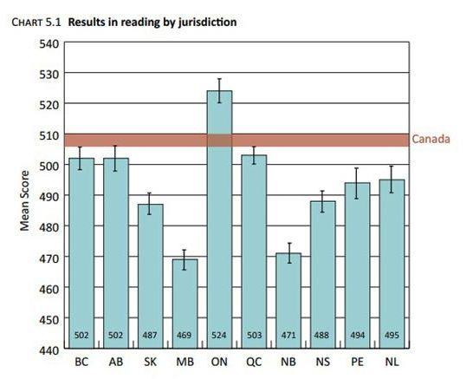
How are we doing in Manitoba?
The lowest reading
scores in Canada !!!
were obtained in
Manitoba, based
on a random
sample of 13-yr.-old
students in 2013.
Pan-Canadian Assessment Program

Slide 11

Current Practices in HSD
1. Tier I Interventions:
Balanced Literacy in regular classrooms
  Guided Reading & (CAFÉ + Daily 5) Whole Language
  Cracking the Phonics Code (reading)
  Words Their Way (spelling)
2. Tier II Interventions:
Reading Recovery (1:1 with “word work”)
Small pull-out literacy groups (e.g., LLI, Bev Tyner)
Fast ForWord software (3 schools)
3. Tier III Interventions:
Resource directed – Barton, Seeing Stars, etc.

Slide 12
Continuing Problems
Some students still not learning to read or spell very well - despite our Tier I & II efforts!
Possible Reasons:
  Phonological awareness
  Orthographic awareness
  Morphological awareness (structural analysis)
  Rapid automatic naming
  Auditory working memory
  Executive dysfunctions (attention, inhibition, RAS)
  Primary language disorder
  Slow learners (IQs from 70-84)
  Intellectual disability (IQs < 70)

Slide 13
Continuing Problems…
Plus, some students have…
Orthographic (surface) dyslexia:
    Trouble with reading & spelling phonetically irregular “sight” words (e.g., said, laugh, pint, yacht, naïve, etc.).
    Spell words as they sound (e.g., “said” = sed; “watch” = woch)
    Difficulty learning how to form letters
    Confused by similar-looking letters (e.g., b/d, p/q, n/u, t/f, etc.)
    Reverse the order of letters in words (from vs. form)
    Trouble remembering word parts (e.g., syllable patterns, prefixes and suffixes).
    Trouble with accurate/rapid word recognition, & reading speed.

Slide 14
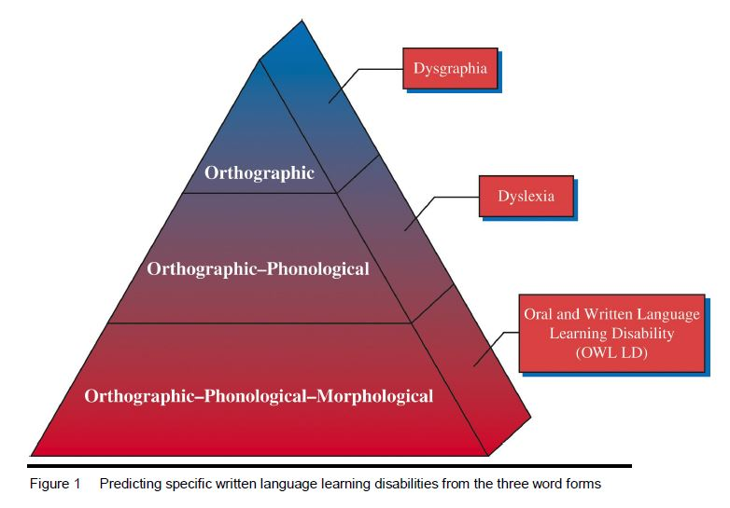
A Clue to a Solution
Dr. Virginia Berninger found that three cognitive processing weaknesses account for most LDs in literacy: orthographic phonological, & morphological awareness.
Common Denominator?
Spelling &/or Handwriting
Orthographic
Word Attack
& Spelling
Orthographic +
Orthographic +
Reading, Spelling,
& Written Expression

Slide 15
Rebalancing Literacy
Lets add Orthographic Awareness instruction to the 5 Essential Reading Components:
Orthographic Awareness
Fluency
Phonemic Awareness
Vocabulary
Phonics
Comprehension

Slide 16
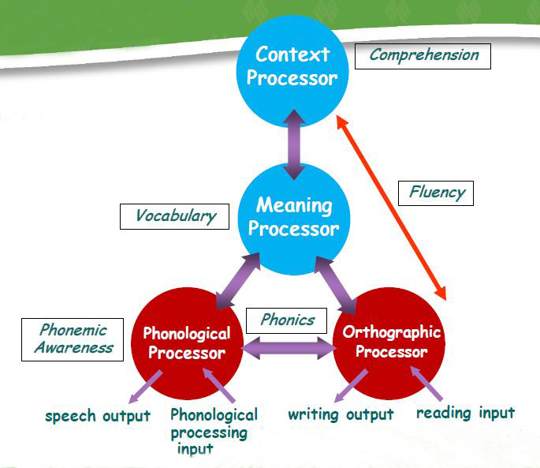
Brain Processors
Orthographic
Awareness
Adapted from M. J. Adams

Slide 17
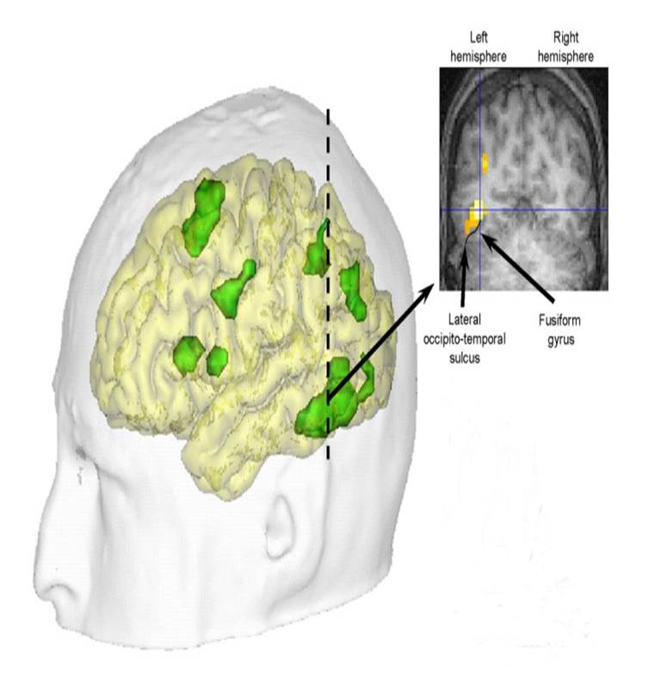

Visual Word Form Area
The brain’s “Letter Box”
Stanislas Dehaene
located deep in the left lateral
occipital-temporal sulcus, part of the fusiform gyrus network.
Orthographic Processor

Slide 18
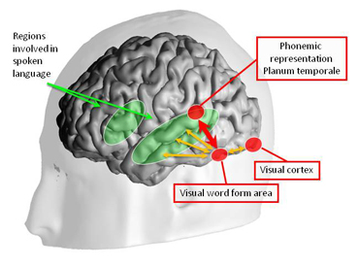
Development of
Orthographic Processing
Neuronal
Recycling
In normal readers,
face recognition
decreases as
word recognition
increases in the visual word-form area
In normal readers
face recognition
increases in the
right fusiform
gyrus
The DANA Foundation June 3, 2013
Stanislas Dehaene, Ph.D.

Slide 19
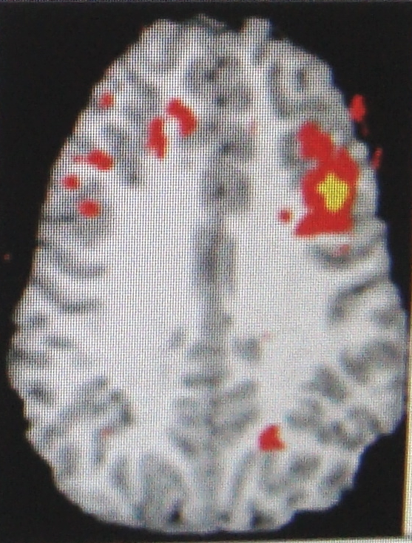
fMRI of the Brain Processing an Orthographic Letter Strings Task
Orthographic
Working Memory
frontal areas
activate
posterior areas.
Adapted from Virginia W. Berninger, Ph.D. (2009)

Slide 20
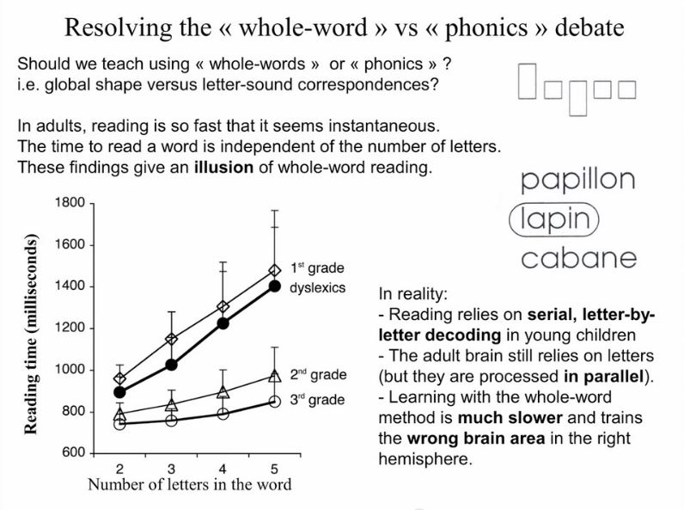
Whole Word or Phonics?

Slide 21
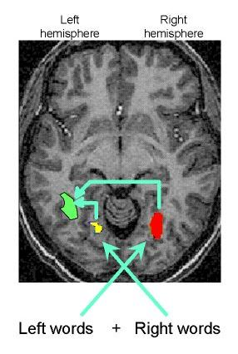


Right Visual Field Better
Reading is a bit slower
(16 ms longer) and more error-prone when words are presented on the left side.
We all see words somewhat better on our right. Presenting letters and words on the right side may facilitate orthographic processing.
200 ms
184 ms

Slide 22
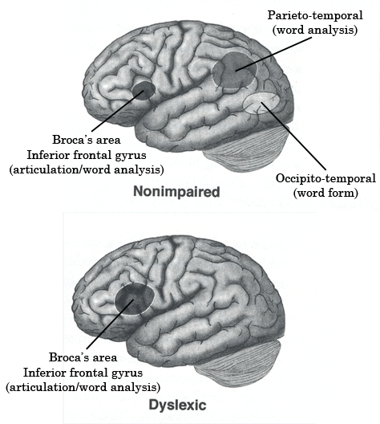

Dyslexic Brain Signature
Dr. Sally Shaywitz
Yale Center for the
Study of Learning & Attention
Overcoming Dyslexia (2003)
88% have a phonological deficit

Slide 23
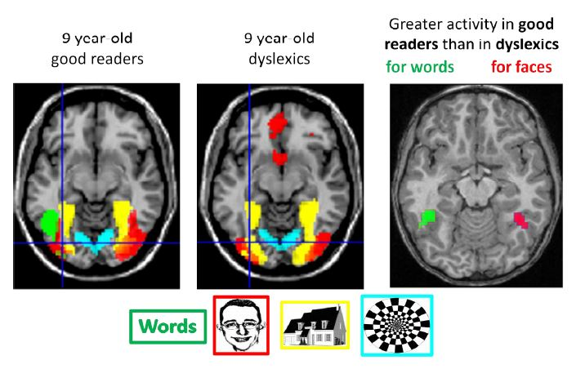
Differences in Orthographic Processing Between Normal & Dyslexic Readers
and

Slide 24
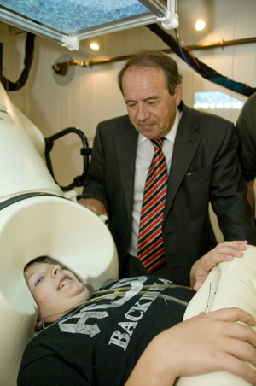
Cross-Validation of Brain Differences in Dyslexia
Dr. Andrew C. Papanicolaou, Director of the Center for Clinical Neurosciences, at the University of Texas Health Sciences Center
Discovered that the dyslexic brain functions differently from that of the normal brain using Magnetoencephalography (MEG).
Results are similar to those found by Dr. Sally Shaywitz at Yale with fMRI.

Slide 25


Bridging Science & Teaching
Virginia Berninger, Ph.D.
University of Washington
Teacher
Psychologist
Neuroscientist
PAL-II Test
Phonemic Awareness Training
Orthographic Training
Talking Letters
Layered Reading & Writing Tutorials
Author of many books & articles
Nanci Bell, M.A.
Lindamood-Bell Learning Center
San Luis Obispo, California
Teacher
Reading clinician
- Visualizing and Verbalizing
- Talkies
- Seeing Stars (1997; 2013)

Slide 26
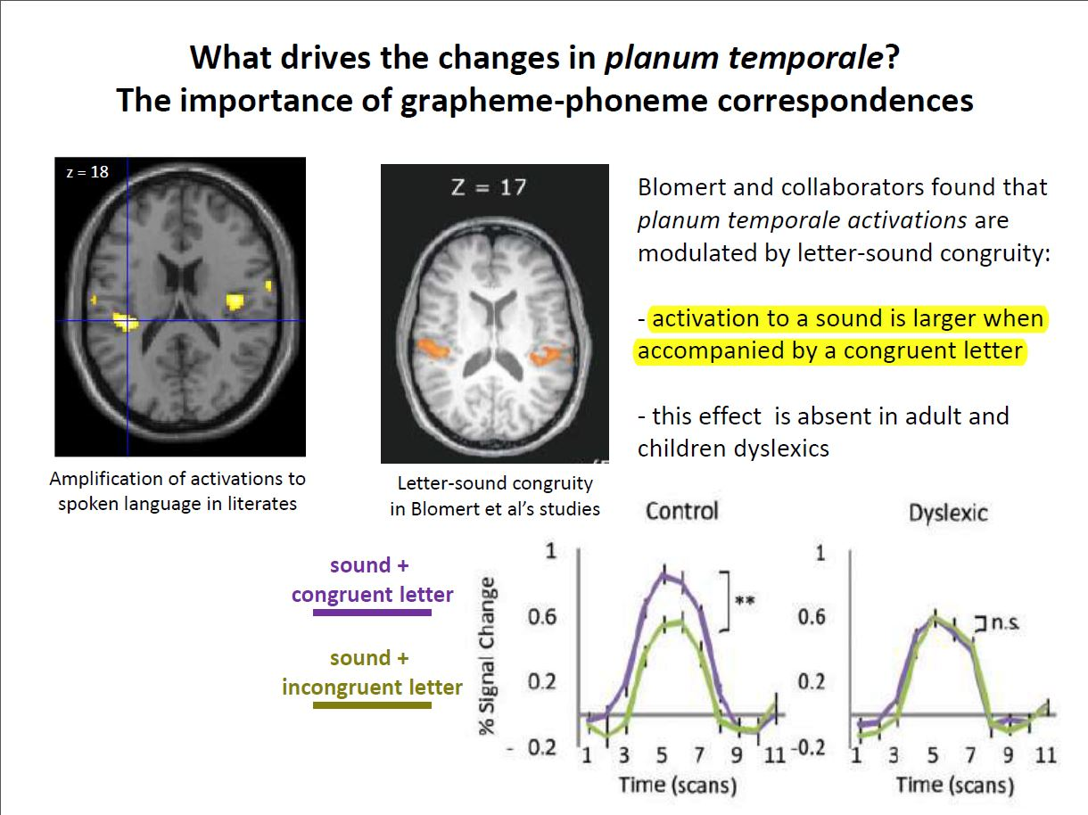
Symbol Imagery?
Nanci Bell, M.A.
  Symbol Imagery – the sensory-cognitive ability to create mental imagery for sounds [heard] and written letters [seen] within words.
  It provides an anchor for phonemes to improve sound discrimination.
    Is there any evidence?

Slide 27
Symbol Imagery?
Nanci Bell, M.A.
  Symbol Imagery – the sensory-cognitive ability to create mental imagery for sounds [heard] and written letters [seen] within words.
  It provides an anchor for phonemes to improve sound discrimination.
  It is the primary sensory input underlying orthographic awareness (i.e., the ability to perceive letter strings and word forms).
  It is integral to independence & automaticity in word attack, word recognition, spelling, and accurate/ fluent contextual reading.

Slide 28
Orthographic Awareness?
Dr. Virginia Berninger
Orthographic is a Greek word meaning letter forms in written words.
Receptive Orthographic Coding: to read and spell words, children have to sequentially encode or input the visual images of written words into working memory in such a way that visual units correspond with phonological units.
Expressive Orthographic Coding: The “orthographic loop” coordinates recall of orthographic codes in working memory with external output through the hand. This supports the integration of reading and spelling written words.

Slide 29
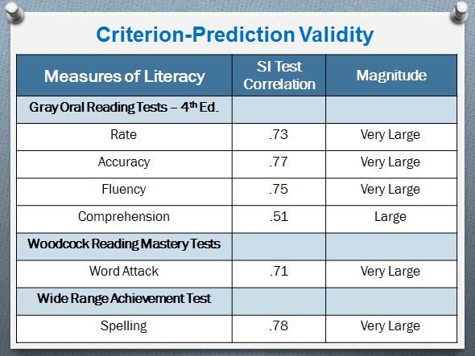
Symbol Imagery Correlates with
Literacy Achievement

Slide 30
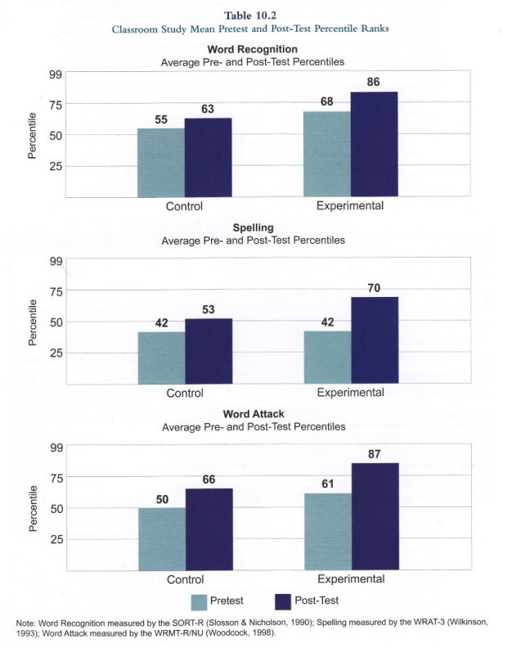
Symbol Imagery Instruction Improves Reading & Spelling > Control Group
Control Group
Experimental Group
8 percentiles
18 percentiles
(10 more)
11 percentiles
28 percentiles
(17 more)
16 percentiles
26 percentiles
(10 more)

Slide 31
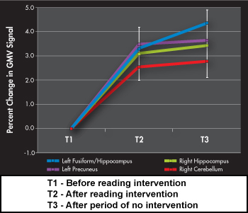
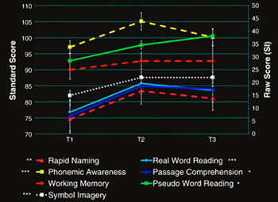
Symbol Imagery Instruction Increased Grey Matter, Reading-Related Processes, & Reading
T1-T2 = 8 weeks
T2-T3 = 8 weeks
Krafnick, Anthony J., D. Lynn Flowers, Eileen M. Napoliello, & Guinevere F. Eden (2011). “Gray Matter Volume Changes Following Reading Intervention in Dyslexic Children.” NeuroImage 57 (3): 733–741.

Slide 32
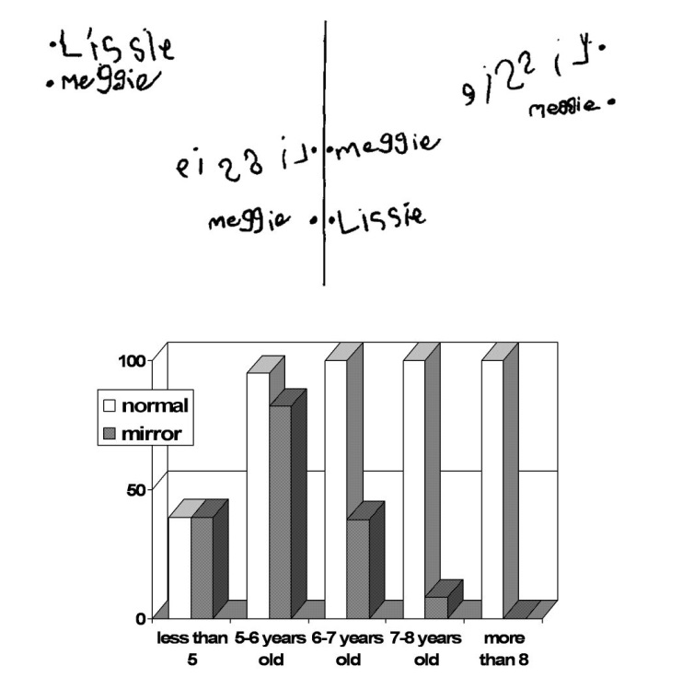
Most of us unlearn mirror imagery
Lissie was
5 years old
Meggie was
6 years old
Mirror =
right-to-left
Normal =
Left-to-right
Notes:
We all gradually unlearn mirror imaging as our left fusiform gyrus becomes more adapted for orthographic processing. The process is much slower and much less effective for those with dyslexia.

Slide 33
Tracing & Air-Writing helps to unlearn mirror imagery
The distinction between right and left (e.g., b/d, p/q) probably begins in the dorsal visual pathway that programs gestures in space.
Progressively, this spatial and motor learning is transferred to the ventral visual pathway for object recognition.
That both the dorsal and ventral pathways need to be trained for reading may explain the remarkable success of teaching methods that emphasize motor gestures [e.g., Fernald, Orton-Gillingham, Slingerland, Bell, etc.].
Stanislas Dehaene (2009) pp. 293-299.

Slide 34
Seeing Stars Program
By: Nanci Bell
Purpose: to develop the ability to image the orthography of language (e.g., letters & letter patterns).
Developmental Sequence:
  1. Imaging single letters (consonants & vowels)
  2. Imaging simple syllables (e.g., CV, VC, CVC).
  3. Imaging complex syllables (e.g., CCV, VCC, CCVC).
  4. Imaging & reading from syllable boards
  5. Decoding lists of words in workbooks.
  6. Using imagery to learn 500 sight words.
  7. Using imagery to spell words.
  8. Imaging multisyllable words (2, 3, & 4 syllables).
  9. Applying imagery to reading in context.

Slide 35
Seeing Stars Intro Video

Slide 36
Seeing Stars Strategies
1. Using visual language. (e.g., What do you picture?)
2. “Air-writing” words while saying each letter, & looking up to the right side to encode the words.
3. Recalling letter positions in sight words.
(e.g., What is the first letter you pictured? What is the third letter? What is the last letter?).
4. Adding, omitting, or substituting letters.
5. Spelling words backwards (e.g., “Say the letters backwards”).
6. Flash card drill with sight words to enhance automaticity.
7. Syllable-board writing with index finger (orthographic loop).
8. Spelling words with a pencil by underlining difficult parts, air-writing them, bolding them, then spelling them from memory.

Slide 37
Exercise: Image letters and sounds.
Trace the letter with your index finger.
Say the letter name, and then the sound it makes.
Once the letter disappears, look up to the right
and picture the letter in your mind.
4. Name & sound the letter as you air write it.

Slide 38
k

Slide 39
Exercise: Image and read sight words
Carefully examine the word I read to you.
Once the word disappears, look up to the right
and picture the word in your mind.
Air-write the word as you name each letter.
Name specific letters I request in the word.
Name the word.
Say the letters you see backwards.

Slide 40
reign

Slide 41
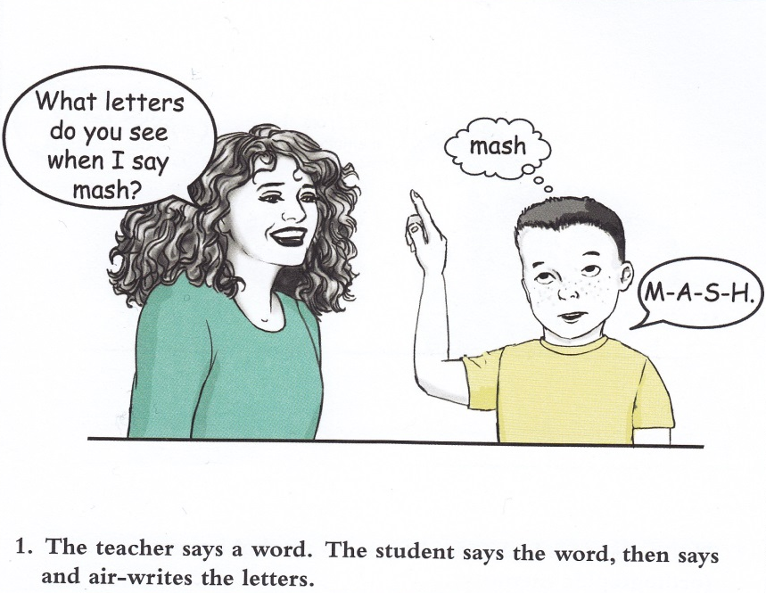

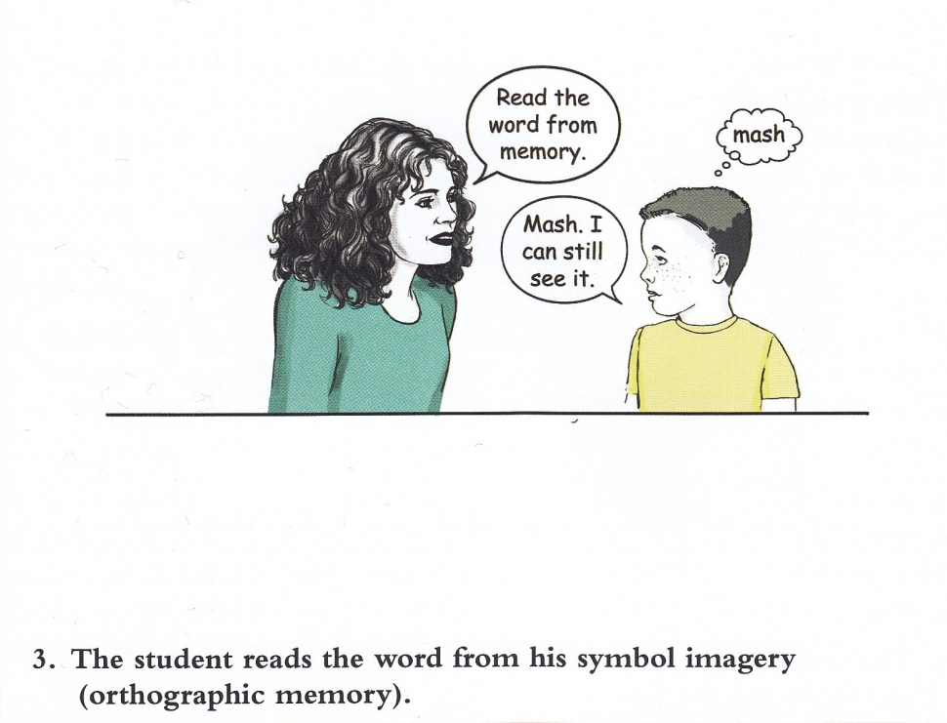


Slide 42
Exercise: Image and Read the Syllable Board
Teacher: Listen to the word I say: “____”
Teacher: Now, you say the word, and tell me the letters you picture for the word.
Student: Says/writes the letters on each line of the syllable board with the index finger.
Teacher: Great! What was the [random position] letter you saw?
Student: Identifies the letter names requested while touching the imaged letters on the syllable board.
Teacher: Good! Now make it say “____.” What letters would you change?
Student: Manipulates the letters and says/writes the new word on the syllable board.
Write all letters in lowercase.

Slide 43
Orthographic Awareness Training
By: Dr. Virginia Berninger
Select words from the students’ reading program to play these games, which are ordered developmentally (e.g., Pre-Primer, Primer, Gr. 1, Gr. 2). These games should never be played for more than 5 to 10 min. in an instructional session or students will lose focus.
Matching Games

Slide 44
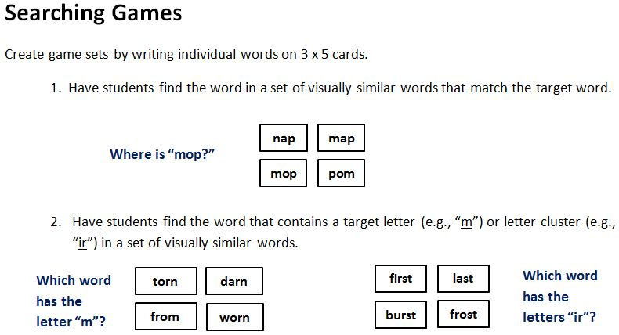

Slide 46
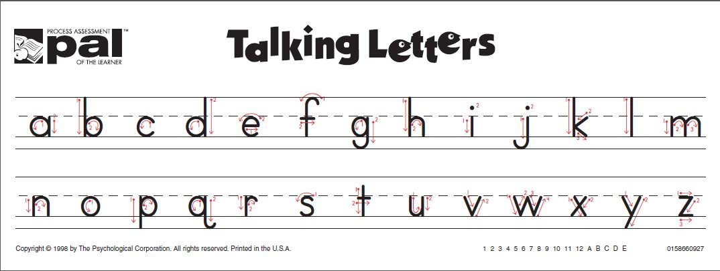
(Exercising the orthographic loop)

Slide 47

Whole Word. Tell student to look carefully at the word as you sweep your finger under it, L-R. Then, cover word. Ask student to spell the word orally from memory. If student is incorrect, repeat the process. When playing in small groups, students should take turns responding.
because
b e c a u s e

Slide 48
Letter in a Word. Tell student to look carefully at the word as you sweep
Your finger under it, L-R. Then, cover word. Ask student to name the letter
in a designated position of the word (e.g., What was the first letter? Third letter?
Last letter?). If student is incorrect, repeat with a letter in a different position.
laugh
L
U
H

Slide 49
Letter Cluster in a Word. Tell the student to look carefully at the word as you sweep a finger under it, L-R. Then, cover the word. Ask the student to name a letter group in designated adjacent positions (e.g., What are the first and second letters? The last two letters? etc.). If the response is incorrect, repeat with a letter cluster in a different position.
clothes
cl
es

Slide 50
Adaptations to Improve
Orthographic Awareness
1. Berninger (2002) also recommends alternating colours for letters, digraphs, and morphemes in words, depending on the instructional focus.
e.g., cat balloon
bake washed
toys black

Slide 51
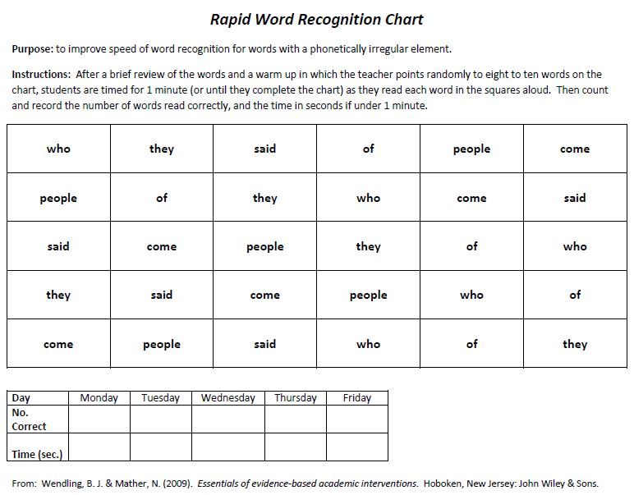
Rapid Word Recognition Chart

Slide 52
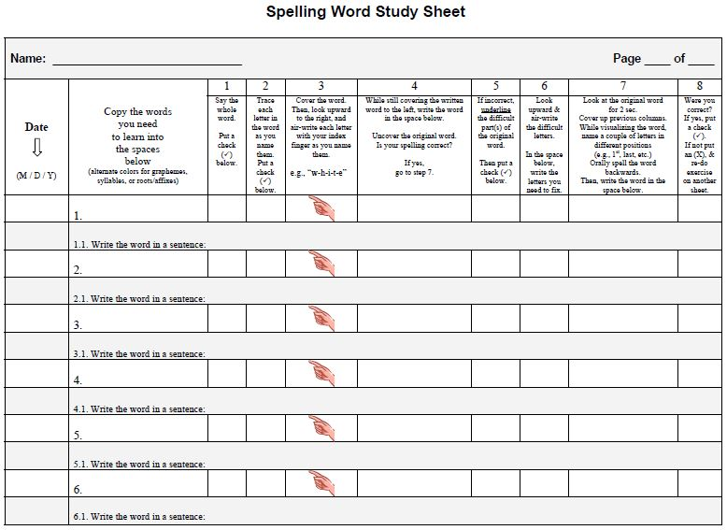

Slide 53
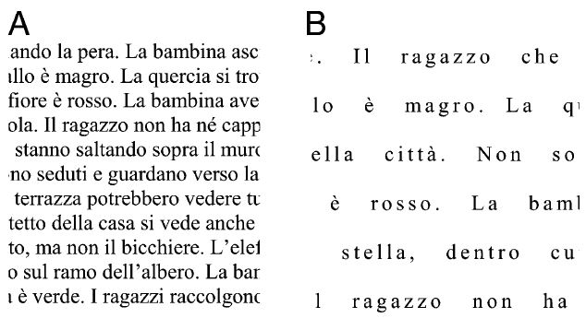
Adapted Text for Dyslexia
In 2012, Dr. Marco Zorzi et al. discovered that increasing the font size to 14, letter spacing by 2.5 pt., and word spacing by 3 characters increases the reading speed of 8-12 yr. old dyslexic children by 20%, and results in half as many reading errors because it compensates for their “perceptual crowding.”

Slide 54
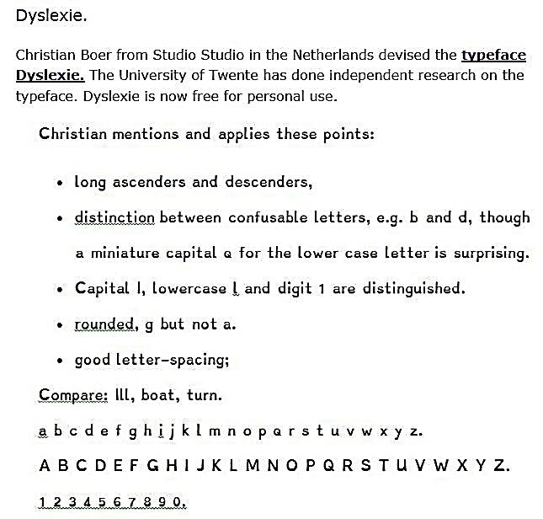
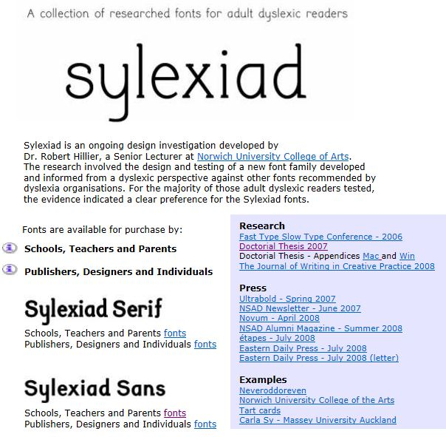
Print Fonts for Individuals with Dyslexia
Dyslexie
Children & Adults
Adults only

Slide 55
Orthographic Strategies
Tracing letters in words with a finger. This aids retention & helps to overcome reversals (e.g., b/d, p/q).
Using visual language (e.g., What do you picture? What do you see?)
Air writing letters, digraphs, and words. Air writing facilitates symbol imagery.
Imaging and identifying letters in different positions within a word.
Adding, omitting or substituting letters to form new words.
Spelling words backwards.
Matching, searching & naming exercises to encode common & unique orthographic features in letters, letter combinations, and words.
Finger writing syllables on strips of paper while imagining them.
Use a rapid word recognition chart for irregular sight words.
Suggestion: Present letters, syllables, and words within a student’s right visual field because it has a more direct route to the brain’s Letterbox area.
Adaptations: - Alternate colors to highlight graphemes in words.
              - For dyslexia, use wider letter spacing & special fonts.

Slide 56
Orthographic Strategies In a
Grade 2 Phonics Lesson

Slide 57

Questions?
Comments?

Slide 58
References
Barry, A. (2008). Reading the past: historical antecedents to contemporary reading methods and materials. Reading Horizons, 49 (1): 31-52.
Bell, N. (2013). Seeing Stars: Symbol Imagery for Phonological and Orthographic Processing in Reading and Spelling. CA: Gander Publishing.
Berninger, V.M. & Richards, T.L. (2002). Brain literacy for educators and psychologists. New York: Elsevier Inc.
Berninger, V.M. & Wolf, B.J. (2009). Teaching students with dyslexia and dysgraphia: lessons from teaching and science. New York: Brookes.
Dehaene, S. (2009). Reading in the brain: the new science of how we read. Penguin Books.
Dehaene, S. (2013). Inside the Letterbox: How Literacy Transforms the Human Brain, Cerebrum. May-June, 2013:7.
Krafnick, A.J., Flowers, D.L., Napolliello, E.M, & Eden, G.F. (2011). Gray matter volume changes following reading intervention in dyslexic children. Neuroimage, 57(3): 733-741.
Mather, N. & Wendling, B.J. (2011). Essentials of dyslexia assessment and intervention. Wiley.
Moats, L. (2007). Whole language high jinks: how to tell when “scientifically-based reading instruction” isn’t. Thomas B. Fordham Institute.
National reading Panel (1999). Teaching children to read: an evidence-based assessment of the scientific research literature on reading and its implications for reading instruction.
Shaywitz, S. (2005). Overcoming dyslexia: a new and complete science-based program for reading problems at any level. Random House.
Wendling, B.J. & Mather, N. (2009). Essentials of evidence-based academic interventions. New Jersey: John Wiley & Sons.
Zorzi, M. et al. (2012). Extra-large letter spacing improves reading in dyslexia. PNAS, 109 (28): 11455-11459.

