Slide 1
selective mutism intervention
Laura Sander
Regional Psychologist’s meeting
September 29, 2023

Slide 2
agenda
WHAT IS SELECTIVE MUTISM (SM)?
BEST PRACTICE INTERVENTION
REAL LIFE INTERVENTION: 2 DIFFERENT CASE STUDIES
DISCUSSSION

Slide 3
SM: first encounter
Unlocking the Mystery of Selective Mutism and Social Anxiety
Aimee Kotrba, Ph.D. (clinical psychologist)
March 9, 2015
DVD – 6 hr recorded seminar
$250
Notes:
Who here has encountered a student with SM?
I encountered my first student in my second year of working and had no idea what to do.
Started researching; there wasn’t a lot of practical information about what to do about it. Came across Aimee Kotrba’s work.
Practices and licensed in Michigan. Private Practice called Thriving Minds where she mainly supporting kids and families with SM. Also is the director of the Neonatal Developmental Clinic at St. Joes Hospital.
DISCLAIMER: I haven’t updated myself on SM research since about 2018. There could be updated information that is not covered here.

Slide 4
what is SM?

Slide 5
what is selective mutism?
Anxiety disorder
90% of kids with SM also have social phobia
SM: fear of speaking
Social phobia: fear of attention
Self-protective, usually not oppositional
Kids aren’t CHOOSING (selecting) to not speak; “select” because it occurs in select environments
Difference between shy and SM:
Shy is a personality style that appears across all environments
SM is an anxiety-based behaviour that only occurs in select environments

Slide 6
what is selective mutism?
Severity
Severe: doesn’t speak outside of the home setting
Moderate: speaks to some school staff members 1-on-1
Mild: answer direct question (quiet, short); doesn’t initiate
NO causal relationship between SM and abuse, neglect, or trauma
10% have experienced; same prevalence as all children
Tend to:
Be intelligent: ~105 FSIQ
Be bilingual: 33%
Have a language disorder or reading disorder

Slide 7
what is selective mutism?
Diagnosis
Easier to treat the earlier it’s diagnosed
DX: 6 months into first year of school experience
Who: doctors (pediatricians, psychiatrists), psychologists, psychiatric nurses, SLP
Assessment
Selective Mutism Questionnaire (SMQ)
School speech questionnaire (SSQ) (not normed)
SCARED or MASC
Non-verbal IQ test

Slide 8
best practice intervention

Slide 9
treatment
“I don’t want to do something, because I don’t want to make it worse”
Research shows that it’s always better to do something than nothing
SM gets harder to treat as the child gets older (e.g. age 15+)
Belief that kids will do well if they can; if they can’t, then what is it in their environment that is preventing that?
Operational definition of success: increase of speech in social situations
Notes:
- SM is a learned behavioural repertoire that occurs through negative reinforcement. Demands to talk > doesn’t respond > demands removed.

Slide 10
treatment
Evidence based treatment:
Behavioral therapy: #1 evidence-based treatment
Medication and parent training (tie)
DIR floor time
Play therapy
Efficacy
Medical: helps 50% of kids
Behavioural: helps 65% of kids
Both: helps 80% of kids
20% who aren’t helped are typically older kids; learned behavioral repertoire
Age 8 and younger easier to treat, age 9 and older harder to treat

Slide 11
steps for implementing treatment
Build rapport
Psychoeducation
Teach to assess own anxiety
Desensitization (exposure therapy)

Slide 12
building rapport
“Hey Jimmy, we get to play together and get to know each other a little bit today, we have toy, game, game, toy; you can pick whatever you want.”
PRIDE:
Praise (labelled)
Reflection: saying back what they say to you
Imitation: doing the same thing they’re doing
Description, behavioral: provide commentary of interaction with child
Excitement: show you like to be there!
Notes:
PRIDE skills same thing as “special play”
No questioning, no teaching (will accidentally reinforce lack of speaking, not as FUN)

Slide 13
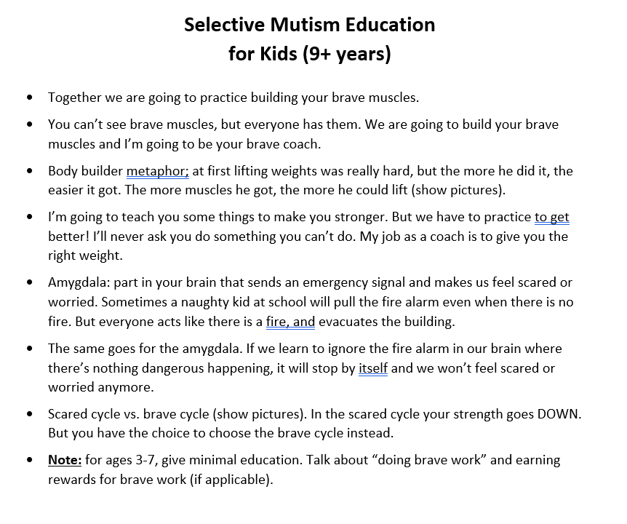
psychoeducation
Younger kids (3-7 years old):
Minimal
Doing Brave Work
Older kids (9+ years old):
See image
Class/friends:
May need to provide
Books: Charli’s choices

Slide 14
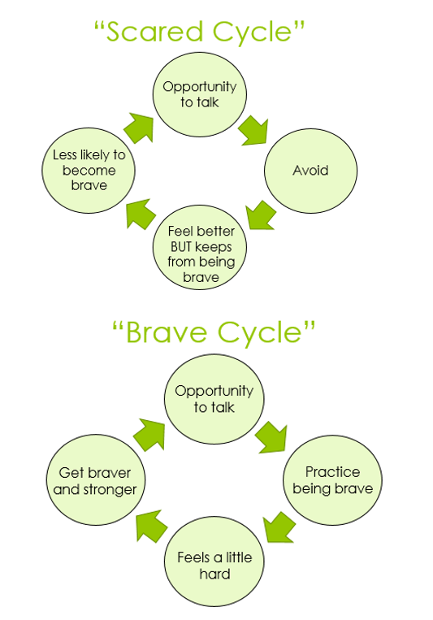
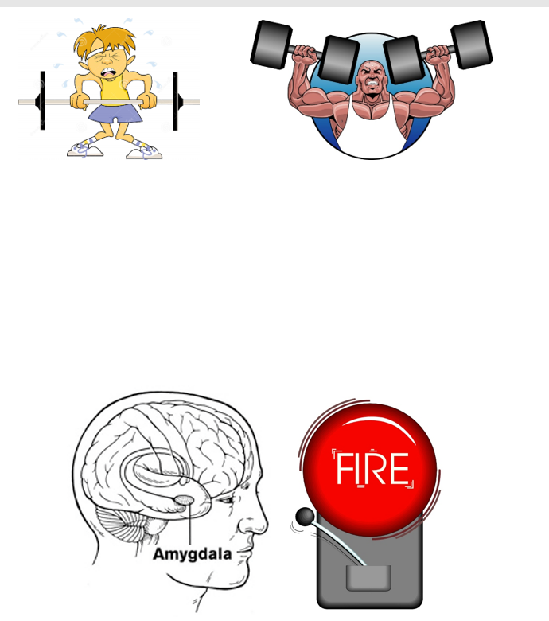
fading

Slide 15
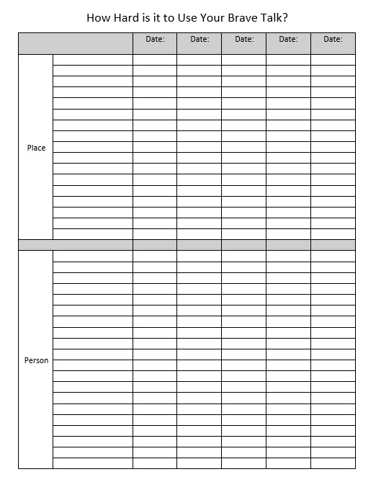
teach to assess own anxiety
Don’t call IT “anxiety”; “how HARD was that?”
How hard would it be to use your brave talk in the library?
Scale 1-10
Helps monitor progress

Slide 16
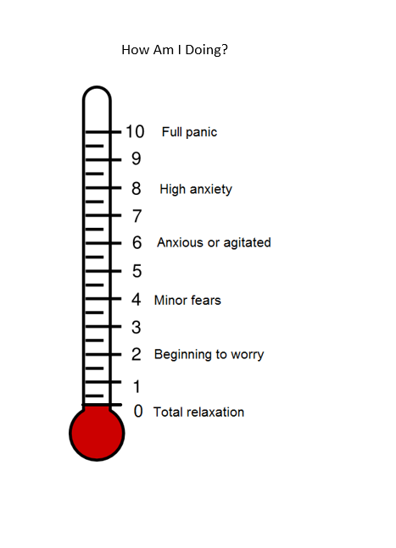
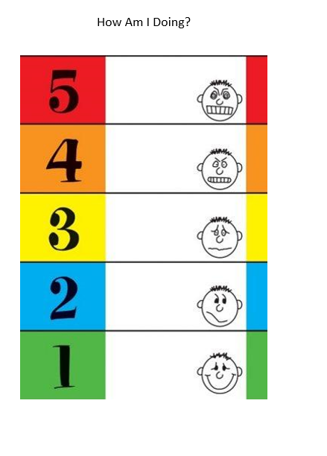

Slide 17
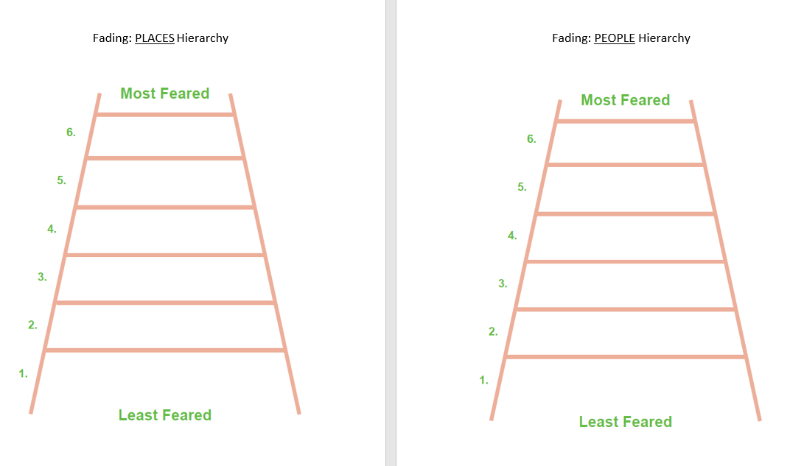
Notes:
- Sit down with the case manager, usually resource, to figure out a plan based on this and what is realistic given EA schedules, space availability, etc.

Slide 18
desensitization (exposure therapy)
Increasing ability to communicate through facing fears at a reasonable pace
Shaping: reinforcing successive approximations to speech. Use when there is no pre-existing speech outside of the home
Stimulus fading: slowly bringing in new people and moving preexisting speech to new places
Escape extinction: for small percentage of kids who don’t want to do the brave work (shaping & fading); use their desire to escape to your benefit
Contingency management: reward system; great to use, not enough on its own
Other:
Cognitive work (ages 13+): Shyness and Social Anxiety Workbook
Social skills instruction: if needed
Notes:
In a lot of modern psychological treatment there’s usually a cognitive piece; for SM treatment, it’s not as effective as behavioural therapy. It can certainly complement it, but it’s not the best evidence based practice. Like phobia based treatment it’s all about gradual desensitization to feared stimulus.

Slide 19
shaping
Use when there is no speech occurring at school; need to get them talking with one person in one place
Communication ladder: start where they’re already at (don’t go below)
Notes:
- Figure out where they are on the ladder first; talk to everyone that knows the kid

Slide 20
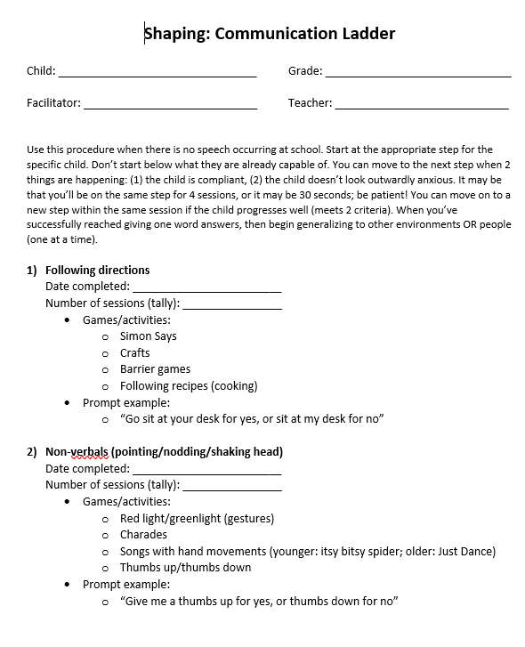
shaping: communication ladder
Following directions
Non-verbals (pointing/nodding/shaking head)
Body sounds
Oral-motor exercises
Blowing air
Voiceless sounds
Voiced sounds
Sound combos
1-word answers
Multiple word answers and longer utterances
Spontaneous initiation of conversation

Slide 21
shaping: communication ladder
You can shape within a step (e.g. balloon)
You can move to a new step when 2 things are happening:
Child is compliant
They don’t look really outwardly anxious
It may be that you’re blowing air for 30 seconds or for 4 full sessions
Can move on to a new step within the same session

Slide 22
generalizing the ladder
What to do when you’ve successfully reached giving one word answers:
Forced choice questions: increase communication demands in situations where talking has been established
Fading: begin generalizing speech to other situations
A note on volume: whispering begets whispering
App: decibel (measures volume)
App: talking tom

Slide 23
Forced Choice Question
First No Response
Wait 5 sec, repeat question
Second No Response
Wait 5 sec, prompt for verbal
Verbal Response
Labeled Praise
Verbal response
No response or nonverbal
Labeled praise
Wait 5 sec, reduce expectations
Notes:
Whomever child is being verbal with asks child a “forced question” (yes/no)
Reduce expectations means take a step back on the ladder
Keep going back on ladder until you get a response
The LAST thing you want is to drop the question and get no response at all

Slide 24
from shaping to fading
Once speech has been established, need to move it to new people or places; breaking the speech boundaries
Fading is easier than shaping
Fading in a new environment is easier than a new person usually
However, a new person is usually more functional (e.g. teacher)
Use the fear hierarchy of people/places established at beginning and reassess every so often
Only change one factor at a time (person or place)
Still practice in original environment occasionally

Slide 25
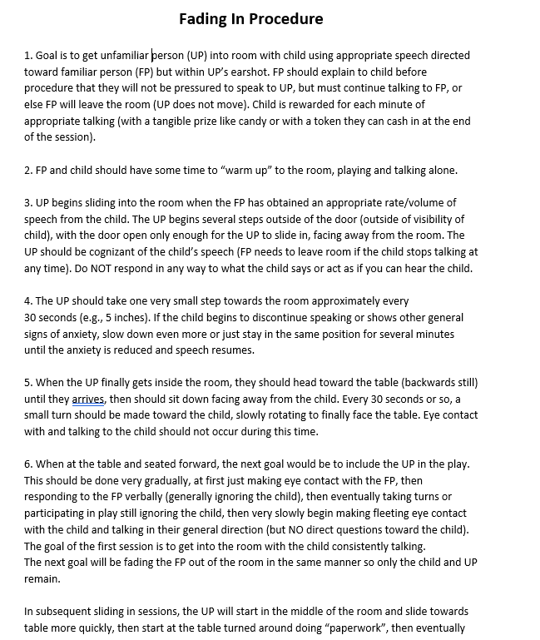
Notes:
This description isn’t school specific, it’s more for private practice so adjust as needed for the school environment
Start with student talking to familiar person continuously; games are a great way to do this

Slide 26
escape extinction
If child isn’t into doing the “brave work”, try:
Set small achievable goals: “Here’s the work you have to do; when you’re done then you can have a prize and leave”
Set timer; have them do the goal (e.g. pointing) for the whole time. Pause if they stop. Prompt if needed
If they don’t care about the timer (want to miss class): have session before the end of school (e.g. wants to go onto the bus, not miss going home)
If child still won’t engage in therapy, then work on parents reducing accommodation; may help kids get better by default
Notes:
What is accommodating? Stepping in and talking for the child.
Child will be more motivated to change when the things they want done aren’t being done by parents anymore

Slide 27
reducing parental accommodation
Protective parenting practices:
LACK of family accommodation: “rescuing” child from anxiety, e.g. speaking for kids, not expecting kids to speak
High expectations: assume kids will be ok and successful, “we’re going to do this; it’s going to be ok”
Being involved at school
Maintaining parenting practices
Accommodations: #1 predictor of maintaining SM. When child gets anxious, parent gets anxious
Social isolation: e.g. parents with anxiety disorder
Denial of an issue: “I was just like them, and I was ok”

Slide 28
reducing parental accommodation
Give education about NOT rescuing:
If you rescue at the height of the fear, you steal the sense of mastery and pride of accomplishment and success
Allow them to ride it out
First time will be really tough!!
After doing it over and over again, it will be ok
6 - 10 times before mastery and before anxiety goes away
When a kid answers, don’t cause a big reaction “wow you talked that’s amazing!”
Labelled praise is good: “thanks for that answer”
Notes:
Education usually involves multiple conversations about how to let their child struggle (conveys message they are capable and they will be ok).
You can be your child’s encourager; just don’t step in and do it for them.

Slide 29
contingency management
Make non-verbal communication not reinforcing
Make VERBAL communication reinforcing
Talking gets the good stuff
Reward system
Plan B: if the child doesn’t order at a restaurant; parent CAN order for them, but talking gets the good stuff. So parent would order food that’s not as appetizing (e.g. veggies).

Slide 30
implementing desensitization
Who does it?
Case manager: person in the school who is responsible for doing the intervention; can be anyone who can be trained, has time, interest, and desire to do what’s best for the kid
Mental health professional outside of school (once a week therapy session and also parent training)
Parent
Notes:
- Case manager: can be school psych, SLP, social worker

Slide 31
treatment course
Have to practice FREQUENTLY. Can’t force a kid to speak, but can certainly prompt with slow steps to speak
At school: 5-10 mins daily or 15-20 mins 3x a week
Outside school: professional therapy session once per week
Parents practicing several times a week (e.g. in community)
Average length of treatment:
3 months: amazingly quick
2 years: usually older kids
Most common cause of regression: someone forced child to talk in a situation when they weren’t ready to talk

Slide 32
“don’ts” for treatment
Don’t mind read; talking gets the good stuff!
Don’t use open ended questions
Don’t show disappointment
Don’t demand verbal manners and proper names (very difficult for kids with SM). Do last.
Don’t say “don’t worry no one can hear you”
Notes:
- Point is for them to get comfortable with being heard

Slide 33
adaptations
Selectivemutism.org has adaptations plan for kids online
Seated next to someone who they talk to or are likely to talk to
Close to teacher, away from door
Allow for early arrival/warm up time in the morning (even 5 mins to make a connection with the teacher)
Evaluation methods:
Videotaping at home, show to teacher > then show to class
Audio record, have them hold up recorder in class
Begin fading in April with the new teacher
Bring friend to next class (but don’t use as a crutch)
Summer school visits if possible
Notes:
In addition to intervention treatment, educational adaptations are often required e.g. for assessment. However, it’s a fine balance between adapting and accommodating their non-speaking

Slide 34
real life intervention

Slide 35
case study #1 (2018)
Female in grade 6 (age 12)
Presenting concerns: disturbing drawings, lack of speech, learning difficulties
Early history: maternal family history of anxiety disorders, maternal smoking during pregnancy, long labour (72 hrs), lazy eye surgery at age 2, toilet training not completed until age 4, older sister also didn’t speak in kindergarten but “grew out of it” by grade 1, separated parents

Slide 36
case study #1
Report cards
Very good achievement: science, gym, music
Good to basic: social studies
Basic: ELA and math
Acceptable attendance
AEP developed in grade 2
Speech/language, social-emotional, math, ELA
Received small group support from resource teacher
Math: 3x per school cycle for whole year
Reading: 3x per school cycle for 6 months
“Go Zen” anxiety program: 3x per cycle for 7 months (1-on-1)

Slide 37
case study #1
Speech at school
Spoke with teacher or resource teacher 1-on-1 in either classroom or RT office with door closed
Assessment
Intervention concurrently with assessment
Used fading procedure with resource teacher; 3 sessions

Slide 38
case study #1
WNV:
NV FSIQ: Low Average (80)
WIAT-III:
Basic reading: Very Low (74)
Reading comp: Average (93)
Mathematics: Very Low (78)
Sentence composition: Low Average (85)
Spelling: Very Low (79)

Slide 39
case study #1
MASC-2:
Parents: Extremely High social anxiety
Student: inconsistent response style; Very High performance fears
SMQ:
At home: speech difficulties are less severe than most children with SM
In public: more severe (mother) and less severe (father)
At school: more severe
DX: Social Anxiety Disorder, confirmed SM

Slide 40
case study #1
Treatment team:
Me
Resource teacher
EA X 2
Classroom teacher
Because she was already talking in some situations at school, we used the fading procedure
I started doing sessions and eventually trained and faded in 2 different EAs to take over
~6 months
Twice a week, 30 mins each

Slide 41
case study #1
Speech BEFORE intervention
People:
Classroom teacher
Resource teacher
Places:
Classroom (empty, door closed)
RT office (door closed)
Speech AFTER intervention
People:
Classroom teacher
Resource teacher
Me
Librarian
2 EAs
2 friends
Places:
Classroom (whispering behind hand)
RT office (door open)
RT outer room (door open)
2 other RT offices (doors open)
Library
Private room in library (door open)
Hallway outside classroom
Conference room (door open)

Slide 42
case study #1
Operational definition of success: increase of speech in social situations
Using the fading procedure, the student improved:
6 steps on the people fear ladder
9 steps on the places fear ladder

Slide 43
case study #2 (2022-2023)
Female in grade 1 (age 7)
Presenting concerns: lack of speech, won’t eat at school, toileting (won’t change soiled pull up or clothing), continues to wear mask, long bangs in face, difficulty separating from mother to get on bus in morning
Background info: mother had SM as child, 1 older sibling with SM currently (high school, wears mask as well, open to CMH), strong academically, good attendance

Slide 44
case study #2
IEP developed
Toileting
Teacher/RT taking for regular bathroom breaks
Shaping behaviour in bathroom also
Private bathroom
Social-emotional
Inviting friend for lunch in a separate room
Intervention plan: fading procedure
Classroom teacher, resource teacher, me, EA, VP, school social work
Classroom adaptations
Notes:
Shaping in bathroom: just going into bathroom, washing hands in bathroom, going into stall, flushing toilet, sitting on toilet fully clothed etc.
Using stuffed animal to model going to the toilet etc.

Slide 45
case study #2
Speech at school
Used to speak with EA and classroom teacher occasionally in kindergarten in the classroom or library
At the start of grade 1 she no longer spoke to anybody
Decided to start with fading
Met with EA (K) for 25 mins in my office (in library) 3x per week
Plan to fade in Laura once she freely spoke with EA
After 19 sessions, still no speech with EA
Switched to shaping on session 20
Started with body sounds since she already did non-verbals

Slide 46
case study #2
Shaping progress extremely slow
Teacher went on leave, had to hire 2 teachers (am and pm) to replace
Started having “meltdowns” at school, hard to determine triggers
Sometimes having an object misplaced (e.g. headband)
Toileting accidents got worse, became oppositional with bathroom breaks and when Mom came to pick her up
Refusing to change mask when soiled (e.g. coughing phlegm) even in private
Attendance started dropping
1 or 2 calls to CFS from community members

Slide 47
case study #2
School social worker became involved
We started working with Mom more
Provided psychoeducation
Asked her to schedule Dr. appointment to rule out physical causes of toileting issues
Mom shared that toileting issues are the same at home; screams when puts on underwear. Even though she talks at home, won’t talk when asked about toileting.
Completed referral for Strongest Families for toileting & anxiety
Started teaching calming strategies and developed “secret signal” with teacher

Slide 48
case study #2
Dr. appointment:
Referred for X-ray of stomach
Referred to Sterling Lyon Pediatrics for ASD rule in/out
Added even smaller steps on the communication ladder to find success
Between step 5 (blowing air) and step 6 (voiceless sounds) we added step 5.5 (blowing air with sounds; e.g. musical instruments played by mouth)

Slide 49
case study #2
March 2023 EA working with student went on leave and I took over fading
April 2023 Mom stopped following up with appointments and referrals
Would agree with us at meetings
Strongest Families referral expired
May 2023 some spontaneous small successes
Making lots of nonsense sounds in hallways and in classroom
Began talking to lunch friend in room with door open; mask off to eat
Whispered in teacher’s ear in classroom

Slide 50
case study #2
Operational definition of success: increase of speech in social situations
Fading/shaping sessions summary:
November 1, 2022 – May 12, 2023
39 sessions
~30 mins each
Shaping (communication ladder):
Began at step 2 of 12 (non-verbals)
Ended at step 9 of 12 (sound combinations; cat sounds)
Student improved 7 steps
Never got to try fading procedure due to lack of one-word utterances
Notes:
Much less success despite younger age and more sessions than first case study
Next steps!?

Slide 51
discussion

Slide 52
resources
Books
Cline, T. & Baldwin, S. (2001). Selective Mutism in Children, Whurr Publishers. Kearney, C. (2010). Helping Children with Selective Mutism and Their Parents: A Guide for School-Based Professionals.
Johnson, M. & Wintgens, A. (2001). The Selective Mutism Resource Manual, Speechmark. McHolm, A., Cunningham, C., & Vanier, M. (2005) Helping Your Child with Selective Mutism: Practical Steps to Overcome a Fear of Speaking, New Harbinger Press.
Schaefer, C. & Freidman, J. (1992). Cat’s Got Your Tongue?, Magination Press.
Shipon-Blum, E. (2003). Understanding Katie, Selective Mutism Anxiety Research and Treatment Center.
Websites
Dr. Kotrba’s Website: www.selectivemutismtreatment.com
The Selective Mutism Group: http://www.selectivemutism.org/
Selective Mutism Foundation: http://www.selectivemutismfoundation.org/
Selective Mutism Information and Resource Association: http://www.selectivemutism.co.uk/component/option,com_frontpage/Itemid,1/
The Anxiety Network International Home Page for Selective Mutism: http://www.anxietynetwork.com/spsm.html
Child Mind Institute Website: http://www.childmind.org/en/clinics/programs/selective-mutism-program

Slide 53
thank you
Laura Sander
lsander@sunrisesd.ca

